Slide 1
Course Outline
0 Getting Started
1 Thinking in Object-Oriended Progarmming
2 The C in C++
3 The basics of C++
4 More advanced topics of C++

Slide 2
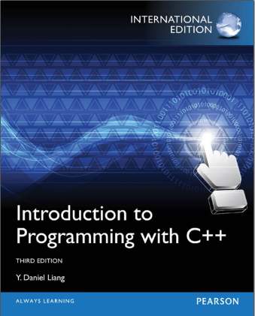
Chapter 9 Objects and classes 9.4 Constructors 9.5 Constructing and Using Objects
Chapter 11 Pointers and dynamic memory management
11.11 The this Pointer
11.12 Destructors

Slide 3
The C in C++
2.1 About variable and type
2.2 About functions
2.3 About constant
2.4 About static elements
2.5 References and The copy-constructor
2.6 Memory manage
2.7 Reading and writing files

Slide 4
2.1 About variable and type
Both languages require that variables be defined before they are used
difference between C and C++ when defining variables
-C forces you to define all the variables at the beginning of a scope
-C++ (not C) allows you to define variables anywhere in a scope
for (int i = 0; i < 100; i++)
unit two\Declarations vs. definitions\def_dec.c

Slide 5
enum 、struct Variable Declarations
In C ：
enum BOOL{false,true};
enum BOOL a;
In C++：
enum DATATYPE{INT,DOUBLE,CHAR};
DATATYPE a;
In C:
typedef enum { INT,DOUBLE,CHAR} DATATYPE;
DATATYPE a;;

Slide 6
Declaration vs. Definition
Declaration introduces a name – an identifier – to the compiler. It tells the compiler “This function or this variable exists somewhere, and here is what it should look like.”
Definition, says: “Make this variable here” or “Make this function here.”
unit two\Declarations vs. definitions

Slide 7
Scope and Visibility
The scope of C++ identifier
-Block scope { }：Local Objects
-File scope ： static Global Objects[c03-static.cpp,
file_static.cpp]
-Global scope ： Global Objects[c03-global.cpp,
Global2.cpp ]
-Class scope： class A{
private: int i;
……
};
Members see all members

Slide 8
storage-class-specifier and lifetime
storage-class-specifier of an object in C and C++
-auto
-register
-static
-extern [c03-forward.cpp]
-typedef
Notes:
typedef说明符并不会为对象预留内存空间。之所以将它称为存储类说明符，是为了语法描述上的方便。

Slide 9
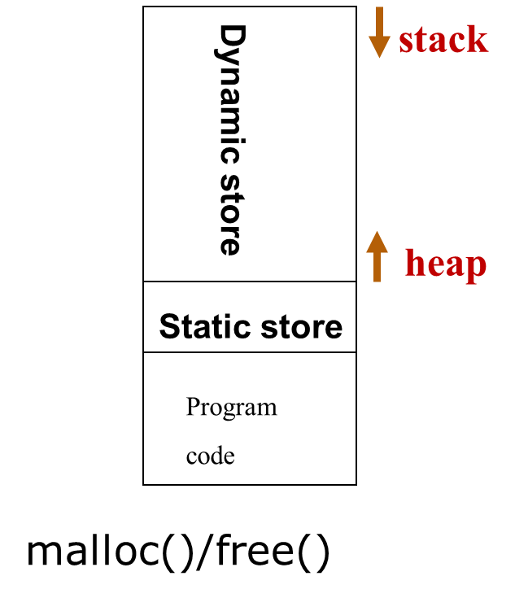
Lifetime
Local lifetime
Items declared with the auto or register
specifier have local lifetime.
Global lifetime
Items declared with the static or extern
specifier have global lifetime.

Slide 10
About Object lifetime
Local object
Global object
Static local object
Static global object
Where and when the constructor / destructor gets called ?
unit three/object_scope

Slide 11
Chapter 9 Objects and classes 9.10 The Scope of Variables

Slide 12
Data type
Built-in : A built-in data type is one that the compiler intrinsically understands, one that is wired directly into the compiler. The types of built-in data are almost identical in C and C++.
Abstract : a user-defined data type is one that you or another programmer create as a class. These are commonly referred to as abstract data types. The compiler knows how to handle built-in types when it starts up; it “learns” how to handle abstract data types by reading header files containing class declarations.

Slide 13
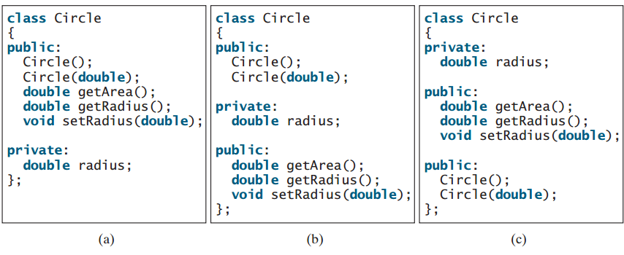

Slide 14
As far as possible consistent-abstract data types and built-in
- code written style；
- Initialization method；
- Assignment mothod ；
- Conversion method；….
int i;
cin >> i;
cout << i;
hoping:
Student s;
cin >> s;
cout << s;

Slide 15
Pointer in C++
object pointer
Student zhangsan(“zhang san ”,22,”Male”);
zhangsan.print()
Student* p = &zhangsan;;
p->print();

Slide 16
Difference between pointer in C and in C++
In C:
int i=1; double d=1.0;
int* pi= &i;
double* pd= &d;
pi = pd; //or pd = pi; complie-time error
but
void* pv;
pv = pi; //ok
pd = pv; //ok
In C++:
pv = pd; //ok
pi = pv; //
pointers/difference between pointers in C and in C++.cpp

Slide 17
pi
pd
In C:
void *pv;
pv = pi;
pd = pv; //or: pd = (double*)pi;

Slide 18
pi
pd
In C:
void *pv;
pv = pi;
pd = pv; //or: pd = (double*)pi;

Slide 19
pi
pd
RESOURCE_LEAK
In C:
void *pv;
pv = pi;
pd = pv; //or: pd = (double*)pi;
*pd = 0; //Illegal memory write operation

Slide 20
pd = (double*)pv; //compiled ok，Unsafe Code
//in C++, you can say:
pd = static_cast<double*>(pv); //best use-pattern

Slide 21
2.2 About functions
function prototype
Before using ,all functions must be declared.
Standard C and C++ use a feature called function prototyping. With function prototyping, you must use a description of the types of arguments when declaring and defining a function.
unit two\function_overloading\functionPrototype.c

Slide 22
In old (pre-Standard) C
//In C, function definition：
float vector_sum(float vector[], int size)
{
//function code
}
float vector_sum(vector, size)
float vector[];
int size;
{
//function code
}
Notes:
Not mandatory for all functions are declared before use. for all the functions that are not declared, if you leave off the function declaration, Compiler roughly defaults : that return value type is integer.

Slide 23
Before using a function:
the function that are not declared
when function declaring，No arguments Information
float vector_sum();
/*In C it means “an indeterminate number of arguments */
Notes:
Not mandatory for all functions are declared before use. for all the functions that are not declared, if you leave off the function declaration, Compiler roughly defaults : that return value type is integer.

Slide 24
Function prototype
In C++
//function definition：
float vector_sum(float vector[], int size)
{
//function code
}
Before using this function:
the function must be declared
float vector_sum(float vector[], int size);
float vector_sum(float [], int);
//bad coding style
Notes:
Not mandatory for all functions are declared before use. for all the functions that are not declared, if you leave off the function declaration, Compiler roughly defaults : that return value type is integer.

Slide 25
Rules (mandatory) ：With no arguments should be declared to have a parameter of type void.
/*function declaration: which tells the compiler there are exactly zero arguments */
void func(void);
/* function definition: In both C and C++, means an empty argument list.*/
void func(void)
{
//…
}

Slide 26
Benefits of the function prototype
Type safety
When the function is called, the compiler uses the prototype to ensure that the proper arguments are passed in and that the return value is treated correctly. If the programmer makes a mistake when calling the function, the compiler catches the mistake.
Implementation hiding
The header file containing the function prototype. If you make a mistake, the compiler will discover it by comparing your function call to the function prototype in the header and tell you about your error.
Notes:
在C++强调声明与实现分离，在头文件声明，具体实现代码在实现文件中。头文件对编译器complier和用户user有用，而实现文件对连接器linker有用。

Slide 27
规则(强制)：函数应当具有原型声明，且原型在函数的定义和调用范围内都是可见的。
原型的使用使得编译器能够检查函数定义和函数调用的完整性/正确性。如果没有函数原型，就不会迫使编译器检查出函数调用当中的若干错误（比如，函数体具有不同的参数数目，调用和定义之间参数类型的不匹配）。事实证明，函数接口是相当多问题的肇因。
对外部函数来说，建议采用如下方法，在头文件中声明函数（亦即给出其原型），并在所有需要该函数原型的代码文件中包含这个头文件。

Slide 28
Chapter 6 Functions
6.8 Function Prototypes

Slide 29
Function Signature
Signature，顾名思义，是用来进行身份识别的一种手段。在编程语言的设计中，必须定义出识别两个不同实体的规则，这种规则也被称作签名规则。比如，C通过函数名来区别两个函数，所以，不允许在同一个编译/链接单元内出现两个同名的函数。到了C++/Java，由于它们支持函数重载，一个函数名可以被赋予不同语义，提供不同的实现，所以它们对函数（方法）的签名规则扩展为：
-函数名 -参数数量 -按照顺序，每一个参数的类型（包括类型修饰符）。

Slide 30
class Foo { public:
void foo(void) { ... }
// the function signature may be Foo_foo
void foo(int a) { ... }
// the function signature may be Foo_foo_int }; Foo m;
m.foo(); // link to Foo::foo(void) bodies.
m.foo(10); // link to Foo::foo(int) bodies.

Slide 31
How to use C library in C++ program?
问题提出：有C实现的组件：grap.h/grap.obj。在用C++实现的应用程序中使用上面组件代码。
在你的C++实现文件中使用函数原型，申明为:
void drawLine(int x1, int y1, int x2, int y2); //先申明
drawLine(beginX, beginY, endX, endY); //后使用
编译通过，链接错误！

Slide 32
How to use C library in C++ program?
C++ obj文件中(被c++编译后)代码可能是：
drawLine_int_int_int_int(beginX, beginY, endX, endY);
但drawLine是一个C函数，grap.obj中drawLine函数仍然叫drawLine。当你试图将obj文件链接为可执行程序时，将得到一个错误，因为链接程序在寻找一个叫drawLine_int_int_int_int的函数，而没有这样的函数存在。

Slide 33
要解决这个问题，你需要一种方法来告诉C++编译器不要在这个函数上进行function Signature 。
/*disable name mangling for all the following function*/
extern "C" {
void drawLine(int x1, int y1, int x2, int y2);
void twiddleBits(unsigned char bits);
void simulate(int iterations);
//…
}

Slide 34
Default arguments
in C++，when function declaring， Parameters can have default values.
//function definition
void delay(int k, int time )
{
//function code body
}
// function declaration
void delay(int k, int time = 300););
//function call
delay(5);
/*be equivalent to delay(5,300);*/

Slide 35
Default arguments inside classes
code/unit two/Default arguments

Slide 36
Key points of the default arguments
Default arguments are only placed in the declaration of a function (typically placed in a header file).
At call, values are bound left-to-right
int f(int, int, int = 3, int = 4);
f(1, 2, 3); // 4th argument defaults to 4
f(1, 2); // 3rd & 4th arguments default
f(2, 4, 6, 8); // no defaults used

Slide 37
Can't intermix default and required parameters
-Required parameters come first in list
-Default parameters come last in list
int h(int, int, int = 3, int = 4); // RIGHT!
int h(int, int = 3, int, int = 4); // WRONG
Default value cannot depend on the values of other arguments,but can be complicated expression or function call
int h(int i, int = i * 5); // ILLEGAL!
void delay(int k, int time=f(5)); //f(5) is function call

Slide 38
【Standard 】（强制）
函数的声明、定义和调用都不采用缺省参数。
【说明】 C++语言可以给函数中的形式参数指定缺省值，但使用缺省值给程序员和修改者增加了不必要的记忆负担，其实这也是C++特性臃肿的一种表现，限制这些不必要的特性能使代码简化，避免可能导致的各种问题，还可以让程序员明确每一个参数的作用，不必担心调用的函数会由于参数的多少而产生不必要的麻烦。

Slide 39
Chapter 6 Functions
6.9 Default Arguments

Slide 40
Function Overloading
In C, every function has a unique name, C++ allows several functions with the same name. because “Function Signature”
Function call binding: Connecting a function call to a function body is called binding.
early binding : When binding is performed before the program is run (by the compiler and linker)
late binding : the binding occurs at runtime, based on the type of the object. Late binding is also called dynamic binding or runtime binding.
unit two\function_overloading

Slide 41
Overloaded function call is static binding

Slide 42
Key points of the function Overloading
Ensure the argument lists are different
typedef float real;
float abs(float) {//……}
real abs(real) {//……}
Return values don’t distinguish overloaded functions
int process(int) {//……}
float process(int) {//……} //compile-time error
Ambiguous Error

Slide 43
int process(int) {//……}
float process(const int) {//……} //compile-time error
BUT:
void foo(A*);
void foo(const A*);
// Above functions are overloaded relation

Slide 44
Class A{
public:
void foo();
void foo() const;
//…
};
//Above functions are overloaded relation.
void foo(A*);
void foo(const A*);
The const becomes part of the function signature
Also overloaded relation

Slide 45
Function overloading in class
constructors overloading
member functions overloading

Slide 46
Chapter 6 Functions
6.7 Overloading Functions

Slide 47
Overloading VS. Default arguments
it can seem confusing at times to know which technique to use.
答案取决于另外两个问题。第一，确实有那么一个值可以作为缺省吗？第二，要用到多少种算法？一般来说，如果可以选择一个合适的缺省值并且只是用到一种算法，就使用缺省参数. 否则，就使用函数重载。
code/unit two/Default arguments

Slide 48
Problem1:实现最多可以计算5个整数的最大值的函数
int max(int a, int b = std::numeric_limits<int>::min(),
int c = std::numeric_limits<int>::min(),
int d = std::numeric_limits<int>::min(),
int e = std::numeric_limits<int>::min());
c++标准库用一种特有的新方法所表示的一个在c里已经定义了的东西

Slide 49
int max(int a, int b, int c ,int d, int e)
{
int temp = a > b ? a : b;
temp = temp > c ? temp : c;
temp = temp > d ? temp : d;
return temp > e ? temp : e;
}
最关键的一点是，不管函数的调用者提供几个参数，max计算时采用的是相同的算法。在函数内部任何地方都不用在意哪些参数是“真”的，哪些是缺省值；而且，所选用的缺省值不可能影响到所采用的算法计算的正确性。这就是使用缺省参数值的方案可行的原因。

Slide 50
Problem2:实现最多可以计算5个整数的平均值的函数
对很多函数来说，会找不到合适的缺省值。例如，假设想写一个函数来计算最多可达5个int的平均值。这里就不能用缺省参数，因为函数的结果取决于传入的参数的个数：如果传入3个值，就要将总数除以3；如果传入5个值，就要将总数除以5。另外，假如用户没有提供某个参数时，没有一个“神奇的数字”可以作为缺省值，因为所有可能的int都可以是有效参数。这种情况下就别无选择：必须重载函数：

Slide 51
double avg(int a);
double avg(int a, int b);
double avg(int a, int b, int c);
double avg(int a, int b, int c, int d);
double avg(int a, int b, int c, int d, int e);

Slide 52
Overloading VS. Default arguments
另一种必须使用重载函数的情况是：想完成一项特殊的任务，但算法取决于给定的输入值。这种情况对于构造函数很常见：“缺省”构造函数是凭空（没有输入）构造一个对象，而拷贝构造函数是根据一个已存在的对象构造一个对象。

Slide 53
//default constructor
complex::complex()
{
realPart = 0.0;
maginaryPart = 0.0;
}
//copy constructor
complex::complex(const complex& obj)
{
realPart = obj. realPart ;
maginaryPart = obj. maginaryPart;
}

Slide 54
Chapter 6 Functions
6.9 Default Arguments

Slide 55
Inline Function
In C, one of the ways to preserve efficiency is through the use of with parameter macros
#define MAX 25 //without parameter macro
#define POWER(X) (X)*(X) //with parameter macro
function call need costs : involved from pushing arguments, making an assembly-language CALL, returning arguments, and performing an assembly-language RETURN
int power(int x)
{
return x*x;
}
inline.h/inline全局.cpp
Notes:
用来替换以下函数，用以提高程序运行效率

Slide 56
Problems of the with parameter macro
The first is also true with C: a macro looks like a function call, but doesn’t always act like one. This can bury difficult-to-find bugs(no type checking、side effect erc).
int x = 10;
int i = POWER(x++); //replaced: (x++)*(x++);
The second problem is specific to C++: the preprocessor has no permission to access class member data. This means preprocessor macros cannot be used as class member functions.
Notes:
#define MAX(a,b) (((a)>(b)) ? (a) : (b))
/*...*/
z = MAX(i++, j);
当a>b时，该定义计算了两次第一个参数而在a<=b时只计算了一次。这样宏调用根据i和j的值，对i憎加了一次或两次。

Slide 57
#include <iostream>
inline float power(int x)
{ return x*x; }
int main()
{
int i = 2;
int j = power(i++);
std::cout << I << j << std::endl;
return 0;
}
inline function
How to work the inline function?
When you use the function, the compiler checks to ensure the call is correct and the return value is being used correctly, and then substitutes the function body for the function call, thus eliminating the function call overhead.

Slide 58
Key points of inline function
在C++中，用inline function来替换带参宏的使用。C++的内联机制和C中的带参宏定义都是为了获得较高的运行速度。使用宏和内联函数增加了代码空间，但减少了程序执行时间 。因为不再有函数调用开销。但C++的内联机制比C中的带参宏定义更安全。
参数的类型和函数返回值的类型都在函数声明中进行明确的指定。这便于编译器发现函数调用中的类型不一致的错误。
如果传入函数的是表达式，则此表达式仅求值一次。

Slide 59
Key points of inline function
内联能提高函数的执行效率，为什么不把所有的函数都定义成内联函数？
内联是以代码膨胀（复制）为代价，仅仅省去了函数调用的开销，从而提高函数的执行效率。如果执行函数体内代码的时间，相比于函数调用的开销较大，那么效率的收获会很少。另一方面，每一处内联函数的调用都要复制代码，将使程序的总代码量增大，消耗更多的内存空间。

Slide 60
Key points of inline function
以下情况不宜使用内联:
a)如果函数体内的代码比较长（超过20行），使用内联将导致内存消耗代价较高；
b)如果函数体内出现循环、switch，那么执行函数体内代码的时间要比函数调用的开销大；
c)假如在程序中,隐含或显式取该函数的地址,则……
d)在程序的Debug版本,不执行内联
Lesson note-(5)

Slide 61
About header files
Header files should be used to declare objects、 functions, inline functions defination, function templates, typedef, macros, classes and class templeates .
Header files should be used to define inline functions and shall not contain or produce definitions of objects or functions that occupy storage.

Slide 62
Inlines inside classes
Any function you define inside a class definition is automatically an inline，but you can also make a function defined out of class inline by preceding it with the inline keyword. However, for it to have any effect, you must include the function body with the declaration, otherwise the compiler will treat it as an ordinary function declaration.
unit two\inline\complex.h test.cpp

Slide 63
Outlines of inline function
以下情况不宜使用内联:
e)类的构造函数和析构函数容易让人误解成使用内联更有效。要当心构造函数和析构函数可能会隐藏一些行为，如“偷偷地”执行了基类或成员对象的构造函数和析构函数。 所以不要随便地将构造函数和析构函数的定义体放在类中。
Notes:
一个好的编译器将会根据函数的定义体，自动地取消不值得的内联（这进一步说明了inline 不应该出现在函数的声明中）。

Slide 64
Key points of inline function
在项目实现过程中什么时间决定一个函数最好是内联函数？
80－20准则说的是大约20％的代码使用了80％的程序资源；大约20%的代码耗用了大约80％的运行时间；大约20％的代码使用了80％的内存；大约20％的代码执行80％的磁盘访问；80％的维护投入于大约20％的代码上；
结论：软件整体的性能取决于代码组成中的一小部分。
Notes:
一个好的编译器将会根据函数的定义体，自动地取消不值得的内联（这进一步说明了inline 不应该出现在函数的声明中）。

Slide 65
【规则5.4.1】（强制） 不要内联超过20 行的函数。
【规则5.4.2】（强制） 不应内联那些包含循环或switch 语句的函数。
【规则5.4.3】（推荐）对于将析构函数定义为内联函数应慎重对待，析构函数往往比其表面看起来要长，因为可能会有一些隐式成员和基类的析构函数被调用。
【说明】 滥用内联将导致程序变慢，内联有可能使目标代码量或增或减，这取决于被内联的函数的大小。内联较短小的存取函数通常会减少代码量，但内联一个很大的函数将显著增加代码量。在现代处理上，由于更好的利用指令缓存，小巧的代码往往执行更快。

Slide 66
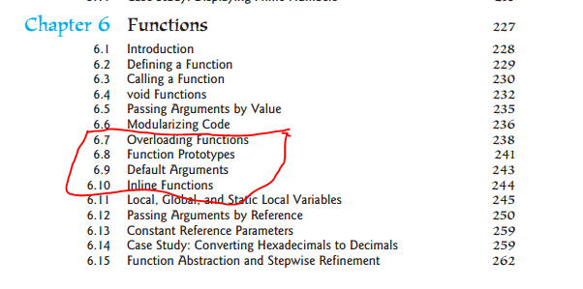
Chapter 6 Functions
6.10 Inline Functions

Slide 67
function prototyping → type-safe
Default arguments → code-shorter
Function Overloading → Eazy to read
inline Founction → Improve performance
Notes:
一个好的编译器将会根据函数的定义体，自动地取消不值得的内联（这进一步说明了inline 不应该出现在函数的声明中）。

Slide 68
The C in C++
2.1 About variable and type
2.2 About functions
2.3 About constant
2.4 About static elements
2.5 References and The copy-constructor
2.6 Memory manage
2.7 Reading and writing files

Slide 69
2.3 About constant
C编码规范【强制】
要避免在代码中使用诸如3.1415926这样的字面常量，而应该用符号名称和表达式替换它们，如PI * radius * height
Constant in C
#define PI 3.1415926
When programming in C, the preprocessor is used to using macros to create constant. Value substitution

Slide 70
#define PI 3.1415926
Problems
PI is only a symbol
have no storage space.
no concept nor facility for type checking,
preprocessor value substitution introduces subtle problems
macro constants have global scope, external linkage

Slide 71
External Linkage
Internal Linkage
unit two\const_linkage\thefile.cpp otherfile.cpp sigh.h
Notes:
全局对象、全局函数、用define定义的常量具有: external linkage

Slide 72
Constant in C++
you can say:
const int bufsize = 100;
Outline:
-Have type information
-Compiler won't let you change it
-internal linkage,unless you make an explicit extern declaration:
extern const int bufsize = 100;

Slide 73
const int bufsize=100;
Outline:
-Normally, bufsize is only a symbol，have no storage space, be a compile-time constant
//in C && C++
int size = 20;
float a[size]; //error
/*in C++, size is a compile-time constant*/
const int size = 20;
float a[size]; //ok

Slide 74
"const" usage
when, why and how to use the const keyword in C++ programming? const has been put to use for ：
Pointers
function arguments, function return types
class data members and member functions
class objects – const complex m(1.1,2.2);

Slide 75
Pointer to const
const int *p;
read ：“p is a pointer, which points to a const int.”
//Usually
const int a = 10;
const int *p = &a; //p points to an int
cout << *p; //only read by p,
*p = 1; //compile-time error
Here’s the mildly confusing part.

Slide 76
Pointer to const
const int *p;
meaning：p is a pointer, which points to int . by p can’t change it(the data pointed to by p ).

Slide 77
void f1(int* p) { *p = *p+1; }
int a = 20;
f1(&a);
int sum(int *p, int size)
{
int total = 0;
……
return total;
}
Hoping : by p can’t change it.
int a[10] = {1,2,3,4,5,6,7,8,9,10};
cout << sum(a,10);

Slide 78
void f1(int* p) { *p = *p+1; }
int a = 20;
f1(&a);
p can be a constant object's address, or the address of ordinary objects
void f1(const int* p) {
*p = 0; //  compile-time error
}
int a = 20; //or const int a=20;
f1(&a);

Slide 79
const int b = 10;
int a = 20;
const int *p = &b; //p points to int or const int
cout << *p; //only read by p,
*p = 1; //can’t write it. Compile-time error
p = &a;
cout << *p; //only read by p,
*p = 1; //can’t write it. Compile-time error
unit two/pointers/constpointers.cpp

Slide 80
const int *q = &a;
cout << *q;
*q = 1; //×
int *p = &a;
*p = *p + 1;
int a = 10;
a = a + 1;
10
0x0001100
00001010
0x0001100

Slide 81
constant pointer
int d = 1;
int* const p = &d;
meaning：“p is a pointer, which is const, that
points to an int.
*p = *p + 1;
p = new int; //compile-time error
int * p = (int*) malloc(10*sizeof(int));
//通过p遍历堆中的10个整数
p++;
free(p); // RESOURCE_LEAK
Notes:
constant pointer

Slide 82
int * const p = (int*) malloc(10*sizeof(int));
int * q = p;
//通过q遍历堆中的10个整数
p++; //  compile-time error
q++;
*p = 10;
*p = *p + 1;
free(p);

Slide 83
int d = 1;
const int* const p = &d;
meaning：“p is a pointer, which is const, that
points to an int，by p can’t change it.”

Slide 84
int sum(const int *a, int size)
{
const int * const p = a + size;
int total = 0;
for ( ; a <= p; a++)
{
total += *a;
}
return total;
}
int a[10] = {1,2,3,4,5,6,7,8,9,10};
cout << sum(a,10);

Slide 85
Character array literals
char* cp = "howdy"; //correct : const char* cp=“howdy”;
*cp = ‘a’;//
This is technically an error because a character array literal (“howdy” in this case) is created by the compiler as a constant character array, and the result of the quoted character array is its starting address in memory. Modifying any of the characters in the array is a runtime error, although not all compilers enforce this correctly. So character array literals are actually constant character arrays. Of course, the compiler lets you get away with treating them as non-const because there’s so much existing C code that relies on this. However, if you try to change the values in a character array literal, the behavior is undefined, although it will probably work on many machines. If you want to be able to modify the string, put it in an array: char cp[] = "howdy"; For example:character_array.cpp

Slide 86
Chapter 11 Pointers and dynamic memory management 11.4 Using const with Pointers

Slide 87
const in Function arguments & return values
Passing by const value
void f1(const int i)
{
i++;  compile-time error
}
You’re making a promise that the original value of the variable will not be changed by the function f1( ). However, because the argument is passed by value, you immediately make a copy of the original variable, so the promise to the client is implicitly kept.

Slide 88
/*p can pointed a constant , or not constant object.*/
void g(const object *p)
{
/*Guaranteed by the compiler: The object pointed to by the p has not been modified.*/
}
object m; //or const object m;
g(&m);

Slide 89
Returning by const value
const int g()
{
return 1;
}
const char* v()
{
return "result of function v()";
// Returns address of static character array
}

Slide 90
For built-in types, it doesn’t matter whether you return by value as a const. Returning by value as a const becomes important when you’re dealing with user-defined types.
complex operator+(const complex& l,
const complex& r);
c = a + b;
a + b = c; //Hey! It compiles!

Slide 91
For built-in types, it doesn’t matter whether you return by value as a const. Returning by value as a const becomes important when you’re dealing with user-defined types.
const complex operator+(const complex& l,
const complex& r);
c = a + b;
a + b = c; //complie-time error

Slide 92
const in Class
const data member and const member function
class A{
const int size; //const data member
public:
int sum() const; // const member function
};

Slide 93
Introducing a question
Array： C/C++对数组的处理是非常有效的。数组和指针能非常和谐地在一起工作，使用指针要比使用数组下标快两倍。
很多编译器(如ANSI/ISO C)没有对使用越界下标的行为作出定义。一个越界下标有可能导致：
a)程序仍能正确运行；
b)程序会异常终止或崩溃；
c)程序仍能运行，但无法得出正确的结果；
d)其它情况；
two/pointers/指针和数组.cpp

Slide 94
小心使用数组最后一个元素的地址。
当把数组作为函数的参数时,必须采取适当的机制告诉函数数组参数的大小。
void sort(int b[], int size);
函数的数组参数仅相当于指向该数组第一个元素的指针，即与
void sort(int *p, int size);等价
数组传递就是地址传递。
But
int strlen(char s[]);
void sort(const int *p, const int size);

Slide 95
Our Goal
Create an integer array class
P
0 0 0 0 0 0 0 0 0 0 0 0 0 0 0 0 0 0 0 0
size(20)
Heap:sizeof(int)*size
Array a(20);
Hoping: size and p are constant
The initial value of the array elements are 0
Unit two\Array.cpp

Slide 96
Our Goal
Create an integer array class
P
0 0 0 0 0 0 0 0 0 0 0 0 0 0 0 0 0 0 0 0
size(20)
Heap:sizeof(int)*size
Array a(20);
Hoping: for(int i =0; i<a.getsize(); i++)
a[i] = i;
Unit two\Array.cpp

Slide 97
Create an integer array class with two data members:
1) const pointer p that points to the beginning of the array;
const int size that indicates the size of the array.
2) when accessing the array , The compiler can perform subscript bounds checking。
Unit two\Array.cpp

Slide 98
Const Data member
class array{
public:
array(int z) : size(z)
{ //… }
private:
const int sizee;//in one object lifetime，this data member is constant，per object has a different constant value
};
The constructor initializer list

Slide 99
The constructor initializer list
This is to remind you that the initialization in the list occurs before any of the main constructor code is executed.
Must using the constructor initializer list to initialize the const data member.

Slide 100
class C{
private:
int n;
const int cint;
int& rint;
public:
C(int param) : cint(5), rint(n)
{ n = param; }
};

Slide 101
class C{
private:
int n;
const int cint;
int& rint;
public:
C(int param) : n(param), cint(5), rint(n)
{ }
};

Slide 102
Review Const
const int bufsize=100;
Normally, bufsize is only a symbol，have no storage space, be a compile-time constant
//in C && C++
int size = 20;
float a[size]; //error
/*in C++, size is a compile-time constant*/
const int size = 20;
float a[size]; //ok

Slide 103
Hope size is a constant at compile time
class bob{
private:
const int size = 20;
int array[size]; // 
};
使用enum不占用对象的存储空间，枚举常量在编译期间被求值
class bob{
private:
enum {size = 20};
int array[size]; //ok
};

Slide 104
const objects and const member functions
const Array b(10);
b.print(); //complie-time error
Here, b is a const object of type Array. For the compiler to enforce constness, it must ensure that no data members of the object are changed during the object’s lifetime. but how is it to know which member functions will change the data and which ones are “safe” for a const object?

Slide 105
Point out faults：
class A{
private:int k;
public: int getk() {return k;}
};
void fun(const A& m)
{
cout<<m.getk()<<endl;
}
first :
int getk() const
{ return k};
Second :
void fun(A& m)
{ //…};

Slide 106
Effective C++: item 21:
as possible using const
As possible using The constructor initializer list

Slide 107
Chapter 10 Object-Oriented thinking 10.6 Constant Member Functions

Slide 108
2.4 About static elements
Static elements from C
-Static variables inside function
-Static class objects
Static members in C++
staticGrammer\StaticInC.cpp
StaticObjects.cpp

Slide 109
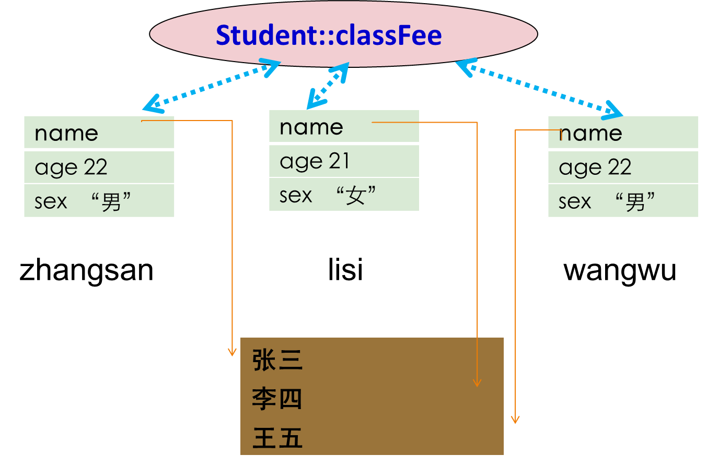
staticGrammer\student.h student.cpp testusingstatic.cpp

Slide 110
Key points of static members of class
静态成员是局部于该类的全局变量。为该类所有的对象所共享。不论创建多少个该类的对象，静态数据成员在内存中只有一个拷贝。
静态数据成员只是在类中声明，必须在类外其它地方初始化，因为它是该类的全局变量。
静态成员与运行的程序有相同的生存期，即使不创建该类的对象，它亦存在。

Slide 111
通常将静态数据成员声明成私有的。在该类的公有区声明一个静态的成员函数，让外界通过该静态成员函数来访问该类的静态数据。
静态成员函数是局部于该类的一个全局函数，只能访问类的静态数据成员，但它不是该类的成员函数(没有this指针)，它同友员函数一样，在类中只有语法上的作用。

Slide 112
Chapter 10 Object-Oriented thinking 10.5 Instance and Static Members

Slide 113
2.5 References and The copy-constructor
References
a reference is just a alias of an exist object.
Which int to reference exactly？is count
int count = 0;
int& refcount = count;
refcount = 1; //here，count=1
count++; //here，refcount=2
refcount is a reference of an int

Slide 114
when, why and how to use the references(&) in c++ programming?
In function: function arguments, function return types

Slide 115
References in functions
The most common place you’ll see references is as function arguments and return values. When a reference is used as a function argument, any modification to the reference inside the function will cause changes to the argument outside the function. Of course, you could do the same thing by passing a pointer, but a reference has much cleaner syntax. (You can think of a reference as nothing more than a syntax convenience, if you want.)
two/Reference/引用.cpp

Slide 116
References in function arguments
When passing an argument to a function should be to pass by:
argument-passsing by valus
argument-passsing by address
argument-passsing by reference

Slide 117
//argument-passsing by values
void f1(const Object obj ){ //… }
Object m;
/*when call, compiler allocate storage for obj to pass an argument by value requires a constructor*/
f1(m);
Call copy-constructor
void f1(const Object& obj) { //… }
Object m;
f1(m);

Slide 118
int *pa1 = &a;
int a;
const int *pa2 = &a;
int& ra1 = a;
int a;
const int & ra2 = a;

Slide 119
function prototyping → type-safe
Default arguments → code-shorter
Function Overloading → Eazy to read
inline Founction and & → Improve performance
const → Improve program robustness
Notes:
一个好的编译器将会根据函数的定义体，自动地取消不值得的内联（这进一步说明了inline 不应该出现在函数的声明中）。

Slide 120
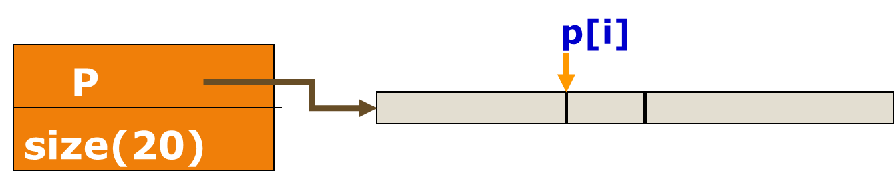
References in function return value
Return a reference from a function
return int&：returns the p[i] unit itself
return int：returns the value of the p[i] unit
Array a(20);
for (int i=0; i<20; i++)
a[i] = i;
two/Array.cpp

Slide 121
Key points of using references:
A reference must be initialized when it is created. (Pointers can be initialized at any time.)
int i;
int& j; //×
j = i;
Once a reference is initialized to an object, it cannot be changed to refer to another object. (Pointers can be pointed to another object at any time.)
int i, k;
int& j = i;
int& j = k; //×

Slide 122
Key points of using references:
A reference and referenced object must have the same type.
int a = 1;
long int && la = a;/*error C2440: “初始化”: 无法从“int”转换为“long &&”
无法将左值绑定到右值引用*/

Slide 123
Key points of using references:
When you pass an argument by value, the argument can be a literal, a variable(may be other type), an expression, or even the return value of another function.
int main()
{
double x = 1;
int y = 1;
inc(y);
inc(x);
inc(20);
inc(20+x);
return 0;
}
void inc(double n)
n++;
}

Slide 124
Key points of using references:
When you pass an argument by reference, the argument must be a variable.
void inc(double& n)
n++;
}
int main()
{
double x = 1;
int y = 1;
inc(x);
inc(y); /*error*/
inc(20); /*error*/
inc(20+x); /*error*/
return 0;
}

Slide 125
You cannot have NULL references. You must always be able to assume that a reference is connected to a legitimate piece of storage.
int a=1;
int &refint1 = NULL; //×
int &refint2 = 5; //× because 5 is constant
const int &refint2 = 5; //√
const int &refint3 = a; //能理解吗

Slide 126
int process(int) {//……}
float process(const int) {//……} //compile-time error
int process(int&) {//……}
float process(int) {//……} //compile-time error

Slide 127
BUT:
void foo(A*);
void foo(const A*);
// Above functions are overloaded relation
void foo(A&);
void foo(const A&);
// Above functions are overloaded relation

Slide 128
If you return a reference from a function, you must take the same care as if you return a pointer from a function. Whatever the reference is connected to shouldn’t go away when the function returns, otherwise you’ll be referring to unknown memory.

Slide 129
int* fn5(void)
{
static int x = 0;
return (&x); //Compliant
}
*(fn5()) = 10;
int* fn1(void)
{
int x = 99;
return (&x); //Non-compliant
}
int* fn2(int y)
{
return (&y); //Non-compliant
}
void fn7(void)
{
static int * p;
{
int y = 99;
p = &y; //Non-compliant
}
}

Slide 130
int& fn3(void)
{
int x;
return x; //Non-compliant
}
int& fn4(int y)
{
return (y); //Non-compliant
}
int& fn5(void)
{
static int x = 0;
return (x); //Compliant
}
fn5() = 10;

Slide 131
#include<iostream> char *f(); char *f1(); int main() { std::cout << f() << std::endl; std::cout << f1() << std::endl; return 0; }
char* f() { char s[] = "Hello"; return s; }
char* f1() { static char s[] = "World" ; return s; }
第一个打印的是乱码，因为s是局部变量，离开f则释放空间 第二个打印正确，因为s是静态变量，整个文件范围类都存在

Slide 132
Member functions shall not return non-const handles to class-data
class Obj
{
public:
int& getA() //Non-compliant
{
return a;
}
private:
int a;
};
void fn(Obj& m)
{
int& a_ref = m.getA();
a_ref = 0;
//External modification of private m.a
}

Slide 133
Pointers vs. References
to see More Effective C++ (WQ version) : item 1指针与引用的区别

Slide 134
Chapter 6 Functions 6.12 Passing Arguments by Reference
6.13 Constant Reference Parameters

Slide 135
The copy-constructor
How passing、returning of user-defined types by value during function calls ?
Object fun(Object m)
{
Object temp;
//…
return temp;
}
Object a,b;
b = fun(a);

Slide 136
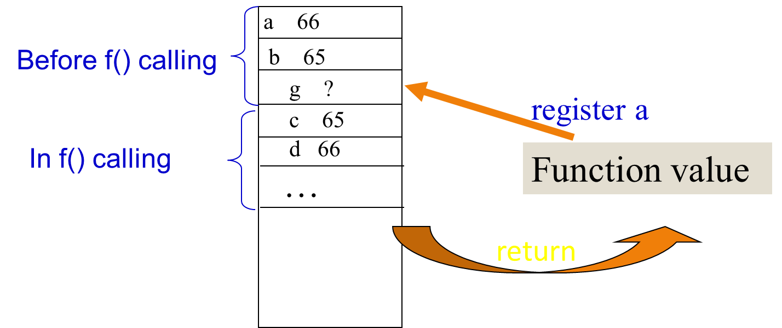
Passing & returning by value in C
If you declare a function and make a function call:
int f(int d, char c);
int g = f(a, b);

Slide 137
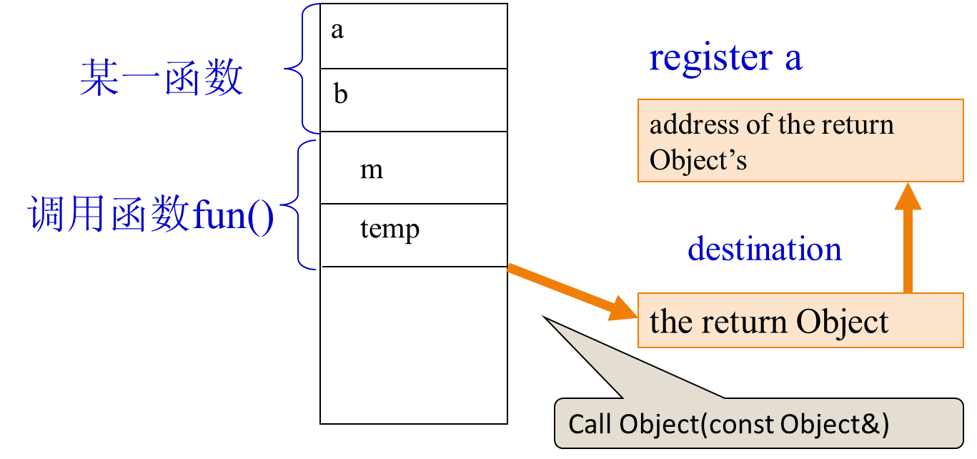
Object a,b;
/*实参对象a传递给形参对象m,调用Object(const bject&)*/
b = fun(a);
Object fun(Object m)
{
Object temp;
//…
return temp;
}
two/copyConstrutor/PassingBigStructures2.cpp PassingBigStructures3.cpp

Slide 138
The complier is done:
pushing the arguments onto the stack (the entire contents of m is pushed on the stack.)
push the address of the return value’s destination on the stack as one of the function arguments (the registers aren’t large enough to hold the return value. )
let the function copy the return information directly into the destination

Slide 139
Passing & returning by Object in C++
a special constructor (requiring references) that makes a new object from an existing object of the same type. The copy-constructor is used by the compiler to pass and return objects by value into and out of functions.
x::x(const x&)
{
//…
}

Slide 140
copy-constructor
The compiler will automatically synthesize a copy-constructor if you don’t provide one yourself. However, the default primitive behavior: a bitcopy.
two/copyConstrutor/DefaultCopyConstructor.cpp
Notes:
大量的类并不需要可拷贝的功能，也不需要一个拷贝构造函数或赋值
操作，不幸的是，不主动声明它们，编译器会自动生成，而且是public 的。C++
中对象的隐式拷贝是导致很多性能问题和bugs 的根源，拷贝构造函数降低了代
码的可读性，相比按引用传递，跟踪按值传递的对象更加困难。

Slide 141
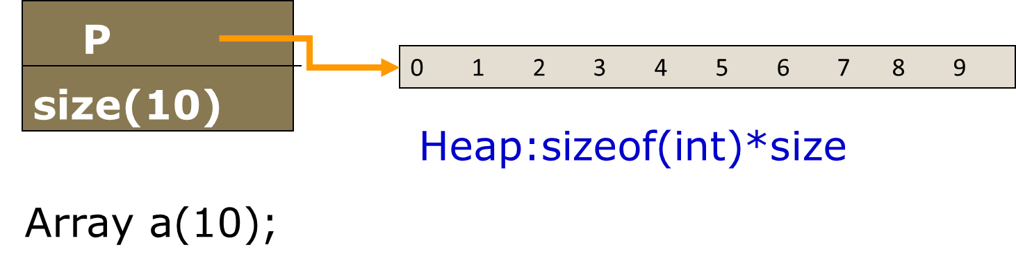

Slide 142
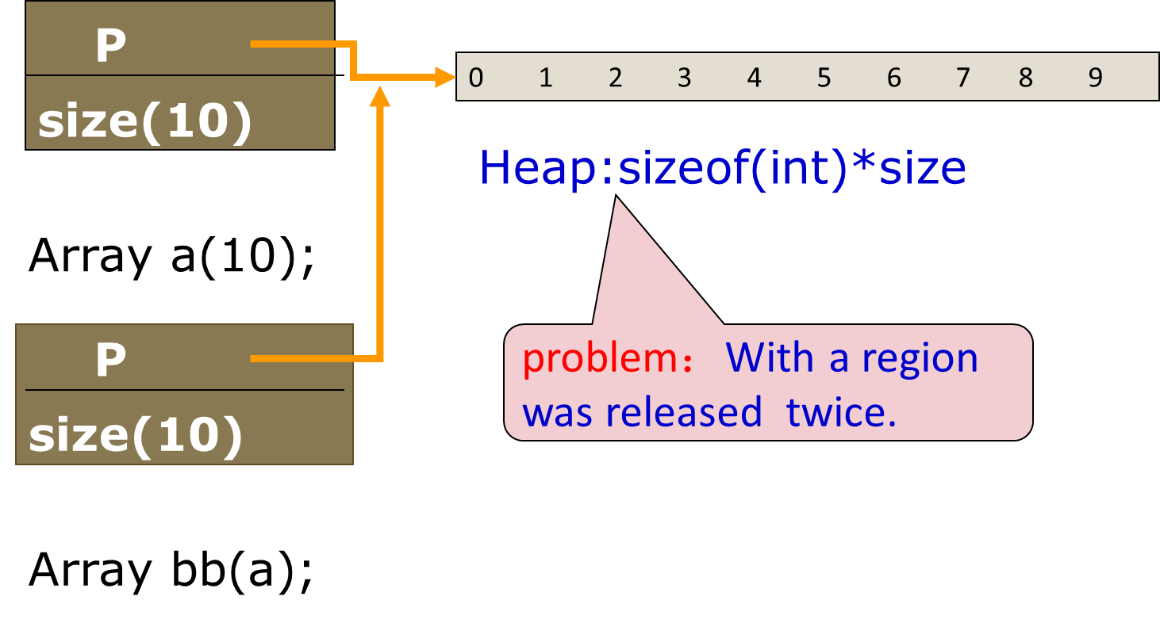

Slide 143
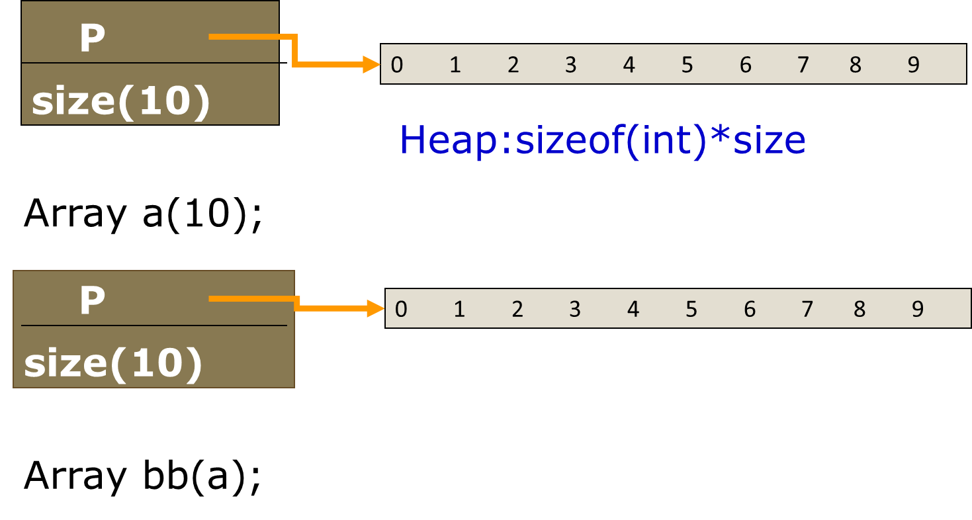

Slide 144
Preventing automatically synthesize
Explicitly disallow the use of compiler-generated functions you do not want
Preventing pass-by-value
There’s a simple technique for preventing pass-by-value: declare a private copy-constructor.
class A
{
private:
A(const A&);
A& operator=(const A&);
} ;
Notes:
大量的类并不需要可拷贝的功能，也不需要一个拷贝构造函数或赋值
操作，不幸的是，不主动声明它们，编译器会自动生成，而且是public 的。C++
中对象的隐式拷贝是导致很多性能问题和bugs 的根源，拷贝构造函数降低了代
码的可读性，相比按引用传递，跟踪按值传递的对象更加困难。

Slide 145
DISALLOW_COPY_AND_ASSIGN macro
参考Google C++ Coding Style，用来限制类型复制和拷贝等对class类型变量的误操作，也可以提高性能，减少编译器自作主张为我们生成一些无法预料的代码。
#define DISALLOW_COPY_AND_ASSIGN (TypeName) \ TypeName(const TypeName&); \ TypeName& operator=(const TypeName&);
Notes:
大量的类并不需要可拷贝的功能，也不需要一个拷贝构造函数或赋值
操作，不幸的是，不主动声明它们，编译器会自动生成，而且是public 的。C++
中对象的隐式拷贝是导致很多性能问题和bugs 的根源，拷贝构造函数降低了代
码的可读性，相比按引用传递，跟踪按值传递的对象更加困难。

Slide 146
使用时，请在class的private声明区中加入以下的代码：
class A
{
private:
DISALLOW_COPY_AND_ASSIGN(A)
} ;
class A
{
private:
A(const A&);
A& operator=(const A&);
} ;
After Precompiled
Notes:
大量的类并不需要可拷贝的功能，也不需要一个拷贝构造函数或赋值
操作，不幸的是，不主动声明它们，编译器会自动生成，而且是public 的。C++
中对象的隐式拷贝是导致很多性能问题和bugs 的根源，拷贝构造函数降低了代
码的可读性，相比按引用传递，跟踪按值传递的对象更加困难。

Slide 147
Chapter 11 Pointers and dynamic
Memory management 11.14 Copy Constructors
11.15 Customizing Copy Constructors

Slide 148
2.6 Memory manage
there are three memory allocation means:
-static memory allocation
-automatic memory allocation
-dynamic memory allocation
C has always provided the functions : malloc( ) and free( ) (along with variants of malloc( ) ：alloc and realoc) that allocate storage from the heap (also called the free store) at runtime

Slide 149
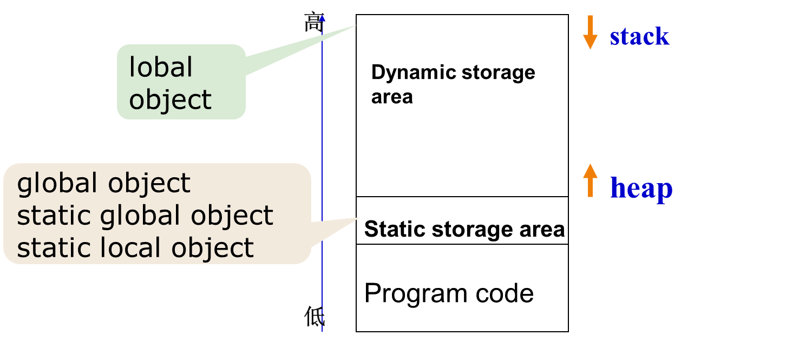

Slide 150
Create and Destroy objects(user define type) at heap
C’s approach to the heap
class A{//…};
A* p = ( A* ) malloc ( sizeof( A ) );
p->A();
//manager *p ... sometime later
p->~A();
free( p );
C++’s new and delete elegantly solve this problem by safely creating objects on the heap:distribute storage and initializtion

Slide 151
C++’s approach to the heap
allocates enough storage on the heap to hold the object and calls the A::A() for that storage.
calss A{//…};
A* p = new A;
A* q = new A( 10 );
//sometime later
delete p;
delete q;
allocates enough storage on the heap to hold the object and calls the A::A(int) for that storage.
first calls the destructor and then releases the memory (often with a call to free( )).

Slide 152
operator new and delete
char *pc1 = new char(‘a’);
//…
delete pc1; //sometime later
int *pi = new int;
*pi = 30;
//…..
delete pi; //sometime later
int *pi = new int[10]; //array
//sometime later
delete[] pi;

Slide 153
规则(强制): 在安全系统中不能使用动态堆的内存分配。
排除了C中的函数alloc、malloc、realoc和free的使用；C++中的运算符new和delete的使用。
涉及动态内存分配时，存在整个范围内的未指定的、未定义的和实现定义的行为，以及其他大量的潜在缺陷。动态堆内存分配能够导致内存泄漏、数据不一致、内存耗尽和不确定的行为。
注意，某些实现可能会使用动态堆内存的分配以实现其他函数，如string.h中的函数。如果这种情况发生，也需要避免使用这些函数。

Slide 154
Chapter 11 Pointers and dynamic
Memory management 11.10 Creating and Accessing Dynamic Objects

Slide 155
2.7 Reading and writing files
In C, the process of opening and manipulating files requires a lot of language background to prepare you for the complexity of the operations. However, the C++ iostream library provides a simple way to manipulate files, and so this functionality can be introduced much earlier than it would be in C.

Slide 156
To open a file for reading, you create an ifstream object, which then behaves like cin.
ifstream
ofstream
To open a file for writing, you create an ofstream object, which then behaves like cout .
fstream
To open files for reading and writing, you must include <fstream>.
C02:Scopy.cpp

